Slide 1
Computer Number Representations

Slide 2
Learning Objectives
The attendee will be able to:
Identify the datatypes available in MATLAB and how each datatype represents numbers
Recognize common customer issues arising from a misunderstanding of how computers represent numbers
Notes:
Chapter 1 Learning Outcomes
The attendee will be able to:
Compile and run a program from the Visual Studio Command Prompt
Declare variables (e.g. float, integer)
Implement formatted input and output
Create an executable in Microsoft Visual Studio C++ 2010 Express
Implement program looping (e.g. for or while loop)
Read/write from/to TXT files

Slide 3
Relevance to TS
Is the “floor” function broken?
>> 0.3/(0.1+0.1+0.1)
ans =
1.000000000000000
>> floor(ans)
ans =
0“
Why can’t I print the following number correctly with “fprintf”
>> a = 558543673819377200
>> fprintf('%.20f\n', a)
558543673819377220.00000000000000000000
Notes:
Chapter 1 Learning Outcomes
The attendee will be able to:
Compile and run a program from the Visual Studio Command Prompt
Declare variables (e.g. float, integer)
Implement formatted input and output
Create an executable in Microsoft Visual Studio C++ 2010 Express
Implement program looping (e.g. for or while loop)
Read/write from/to TXT files

Slide 4
Outline
What are Datatypes?
Datatypes Available in MATLAB
Integer Datatypes
Fixed Point Datatypes
Floating Point Datatypes
Introduction to Numerical Linear Algebra
Notes:
Outline
Building a C Executable
Exercise: Build and execute
Declaring variables
Formatted Input/output
Exercise: Read and print
Microsoft Visual Studio C++
File Input/output
Exercise: File I/O

Slide 5
What are Datatypes?
What the computer stores:
11001011
Datatype
What we think it means:
203
Notes:
Outline
Building a C Executable
Exercise: Build and execute
Declaring variables
Formatted Input/output
Exercise: Read and print
Microsoft Visual Studio C++
File Input/output
Exercise: File I/O
To the computer, everything is just 1’s and 0’s. The datatype is what gives those 1’s and 0’s meaning as representing a number. (In this example, the datatype is uint8)

Slide 6
What are Datatypes?
The same bits can represent different numbers…
11001011
11001011
uint8
int8
203
-53
Notes:
Outline
Building a C Executable
Exercise: Build and execute
Declaring variables
Formatted Input/output
Exercise: Read and print
Microsoft Visual Studio C++
File Input/output
Exercise: File I/O
We’ll be covering the details of these datatypes in the coming sections

Slide 7
What are Datatypes?
…and the same number can be represented with different number of bits.
11001011
01000011010010110000000000000000
uint8
single
203
203
Notes:
Outline
Building a C Executable
Exercise: Build and execute
Declaring variables
Formatted Input/output
Exercise: Read and print
Microsoft Visual Studio C++
File Input/output
Exercise: File I/O
We’ll be covering the details of these datatypes in the coming sections . Note here that in the case of the single datatype, the interpretation of the bits are not as straightforward as in the case with unit8. We will be covering the iee754 standard later down the presentation.

Slide 8
The MATLAB Array (mxArrays)
All MATLAB variables (including scalars, vectors, matrices, strings, cell arrays, structures, and objects) are stored as MATLAB arrays
The mxArray structure :
Type
Dimensions
Data associated with this array
If numeric if the variable is real or complex
It sparse, its indices and nonzero maximum elements
If a structure or object, the number of fields or field names.
Use the matrix library to work with mxArrays
Notes:
http://www.mathworks.com/help/matlab/cc-mx-matrix-library.html
http://www.mathworks.com/help/matlab/matlab_prog/memory-allocation.html

Slide 9
Numeric Datatypes in MATLAB
Integer types
Unsigned (uint8, uint16, uint32, uint64)
Signed (int8, int16, int32, int64)
Fixed point types
Fixed Point Designer (CDA)
Floating point types
Single and Double
Notes:
Outline
Building a C Executable
Exercise: Build and execute
Declaring variables
Formatted Input/output
Exercise: Read and print
Microsoft Visual Studio C++
File Input/output
Exercise: File I/O
We’ll be talking about the different datatypes and how MATLAB uses them to represent numbers.

Slide 10
Complex Matrices
Real and complex parts are kept as separate matrices (to MATLAB, but the customer sees it as one matrix)
Complex matrices take twice as much memory as real matrices
If all imaginary parts in a matrix are 0, MATLAB will drop the imaginary part to save memory.
Imaginary unit is denoted by ‘i’.
Customers can use ‘j’, but MATLAB will still display ‘i’.
Notes:
Outline
Building a C Executable
Exercise: Build and execute
Declaring variables
Formatted Input/output
Exercise: Read and print
Microsoft Visual Studio C++
File Input/output
Exercise: File I/O
The second bullet point here is important. In order to determine whether all the imaginary parts are 0, MATLAB has to scan (potentially) the whole matrix. For a large matrix, this can take a long time and lead to customers contacting us about weird performance behavior.

Slide 11
Sparse Matrices
Technically a matrix attribute, rather than a datatype
Stores only the non-zero values in the matrix
Can save a significant amount of time and memory for matrices that are mostly 0.
Many matrix functions (eye, ones, rand, …) have sparse counterparts (speye, spones, sprand)
Notes:
Outline
Building a C Executable
Exercise: Build and execute
Declaring variables
Formatted Input/output
Exercise: Read and print
Microsoft Visual Studio C++
File Input/output
Exercise: File I/O
Sparse matrices are covered in much more detail in the SIT plan.

Slide 12
Unsigned Integers
Use the position of the bit to represent the power.
Largest number representable with N bits: 2^{N}-1
Distance between consecutive numbers: 1
MATLAB data types: uint8, uint16, uint32, uint64
Bits
1 | 1 | 0 | 0 | 1 | 0 | 1 | 1
2⁷ | 2⁶ | 2⁵ | 2⁴ | 2³ | 2² | 2¹ | 2⁰
128 | 64 | 0 | 0 | 8 | 0 | 2 | 1
Position
+
+
+
+
+
+
+
= 203
Notes:
Outline
Building a C Executable
Exercise: Build and execute
Declaring variables
Formatted Input/output
Exercise: Read and print
Microsoft Visual Studio C++
File Input/output
Exercise: File I/O
Each uint* uses this encoding scheme where * is the number of bits. Thus, for example, a uint64 has 64 bits, so the largest number it can represent is 18,446,744,073,709,551,615 while a uint8 can only represent up to 255.

Slide 13
Signed integers
“Obvious” representation:
Called “signed magnitude” representation.
Computers don’t actually store signed integers this way.
1 1 0 0 1 0 1 1
+/-
Treat like uint7
Notes:
Outline
Building a C Executable
Exercise: Build and execute
Declaring variables
Formatted Input/output
Exercise: Read and print
Microsoft Visual Studio C++
File Input/output
Exercise: File I/O
One problem with signed magnitude representation: 10000000 represents negative 0.

Slide 14
Signed integers
Obvious” representation:
Add (11001011) to (01001011) , with simple rules of binary arithmetic, what do you get?
What does (10000000) stand for?
1 1 0 0 1 0 1 1
+/-
Treat like uint7
Notes:
Outline
Building a C Executable
Exercise: Build and execute
Declaring variables
Formatted Input/output
Exercise: Read and print
Microsoft Visual Studio C++
File Input/output
Exercise: File I/O
One problem with signed magnitude representation: 10000000 represents negative 0.

Slide 15
Signed integers
Actual representation:
Called “Twos complement” representation.
Easy to design hardware to implement arithmetic with this representation
MATLAB data types: int8, int16, int32, int64
1 1 0 0 1 0 1 1
+/-
Treat like uint7, but subtract from 2⁷ if negative
Notes:
Outline
Building a C Executable
Exercise: Build and execute
Declaring variables
Formatted Input/output
Exercise: Read and print
Microsoft Visual Studio C++
File Input/output
Exercise: File I/O
Other numbers of bits work the same way; just replace 7 with 15, 31, or 63 as appropriate.
Interesting consequence: the representation of -1 is always all ones.

Slide 16
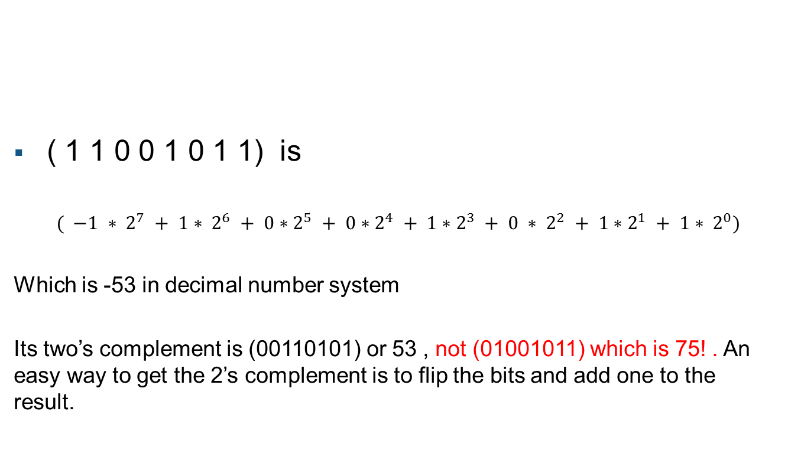
Signed integers
1 1 0 0 1 0 1 1
( 1 1 0 0 1 0 1 1) is
$$( −1 ∗ 2^{7} + 1∗ 2^{6} + 0∗2^{5} + 0∗2^{4} + 1∗2^{3} + 0 ∗ 2^{2} + 1∗2^{1} + 1∗ 2^{0})$$
Which is -53 in decimal number system
Its two’s complement is (00110101) or 53 , not (01001011) which is 75! . An easy way to get the 2’s complement is to flip the bits and add one to the result.
+/-
Treat like uint7, but subtract from 2⁷ if negative
Notes:
Outline
Building a C Executable
Exercise: Build and execute
Declaring variables
Formatted Input/output
Exercise: Read and print
Microsoft Visual Studio C++
File Input/output
Exercise: File I/O
Other numbers of bits work the same way; just replace 7 with 15, 31, or 63 as appropriate.
Interesting consequence: the representation of -1 is always all ones.

Slide 17
Table of Integer Types
 | Range for Unsigned | Range for Signed | Bytes
int8 | 0 to 255 | -128 to 127 | 1
int16 | 0 to 65,535 | -32,768 to 32,767 | 2
int32 | 0 to 4,294,967,295 | -2,147,483,647 to 2,147,483,647 | 4
int64 | 0 to 2⁶⁴-1 | -2⁶³ to 2⁶³-1 | 8
Q: For signed datatypes, why is the negative limit an even number
while the positive limit an odd number?
Notes:
Outline
Building a C Executable
Exercise: Build and execute
Declaring variables
Formatted Input/output
Exercise: Read and print
Microsoft Visual Studio C++
File Input/output
Exercise: File I/O

Slide 18
Fixed Point Datatypes
So how can we represent decimals? Fixed point datatypes
Just like integer datatypes, but with the decimal point shifted.
Example: (8 bits, with a shift of 5)
1 1 0. 0 1 0 1 1.
Notes:
Outline
Building a C Executable
Exercise: Build and execute
Declaring variables
Formatted Input/output
Exercise: Read and print
Microsoft Visual Studio C++
File Input/output
Exercise: File I/O
In fact, integer datatypes are just a special case of fixed point datatypes in which the shift is 0.

Slide 19
Fixed Point Datatypes
So how can we represent decimals? Fixed point datatypes
Just like integer datatypes, but with the decimal point shifted.
Example: (8 bits, with a shift of 5)
1 1 0. 0 1 0 1 1
Treat like uint8, but multiply by 2⁻⁵
Notes:
Outline
Building a C Executable
Exercise: Build and execute
Declaring variables
Formatted Input/output
Exercise: Read and print
Microsoft Visual Studio C++
File Input/output
Exercise: File I/O
In fact, integer datatypes are just a special case of fixed point datatypes in which the shift is 0.

Slide 20
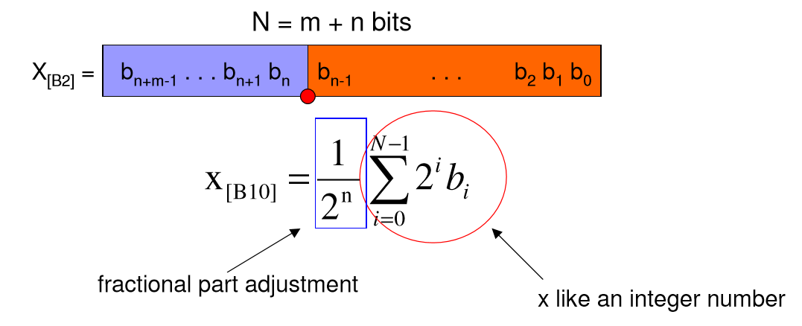
Fixed Point Datatypes

Slide 21
Fixed Point Datatypes
The shift is encoded in the datatype (rather than the data itself), so the decimal point is “fixed”.
Base MATLAB does not have any fixed point datatypes.
Fixed Point Designer (CDA) provides support for fixed point datatypes for hardware.
Notes:
Outline
Building a C Executable
Exercise: Build and execute
Declaring variables
Formatted Input/output
Exercise: Read and print
Microsoft Visual Studio C++
File Input/output
Exercise: File I/O
In fact, integer datatypes are just a special case of fixed point datatypes in which the shift is 0.

Slide 22
Drawbacks of Fixed Point Datatypes
Low dynamic range
To distinguish values differing by 1e-6, we need a shift of 20
This leaves a small number of bits to represent the integer part
Inconsistent relative error
When representing large numbers, the low order bits are wasted on storing noise
When representing small numbers, the high order bits are wasted on storing 0’s.
Notes:
Outline
Building a C Executable
Exercise: Build and execute
Declaring variables
Formatted Input/output
Exercise: Read and print
Microsoft Visual Studio C++
File Input/output
Exercise: File I/O
64 bits is equivalent to about 19 digits. For numbers at the top of this range, this means that we are storing 19 decimal places of accuracy. When was the last time you used an instrument that gave you 19 significant figures?
At the other end of the spectrum, you are going to see a lot of round-off error. With a shift of m, you can only represent multiples of 2^-m, so your data is going to get rounded to the nearest 2^-m. If the fluctuations in your data are small compared to 2^-m, they are going to get swamped by rounding.

Slide 23
Floating Point Datatypes
Stores the shift as part of the data itself.
Analogous to scientific notation for numbers.
Example: (64 bit double precision)
0 10000000110 1001011000000000000000000000000000000000000000000000
Sign
Shift
Data
Notes:
Outline
Building a C Executable
Exercise: Build and execute
Declaring variables
Formatted Input/output
Exercise: Read and print
Microsoft Visual Studio C++
File Input/output
Exercise: File I/O
The representation and arithmetic of floating point types is defined in the IEEE standard 754. This means that basic arithmetic (addition, multiplication…) should give exactly the same result in any standards-compliant language.

Slide 24
Floating Point Datatypes
MATLAB provides two floating point datatypes:
single (32 bits)
double (64 bits)
By default, every variable in MATLAB is of ‘double’ type.
Notes:
Outline
Building a C Executable
Exercise: Build and execute
Declaring variables
Formatted Input/output
Exercise: Read and print
Microsoft Visual Studio C++
File Input/output
Exercise: File I/O
MATLAB uses IEEE 754 double-precision as its default datatype, so we’ll spend some time going through the details.

Slide 25
IEEE 754 Double Precision
Represents the number,
0 10000000110 1001011000000000000000000000000000000000000000000000
Sign
Shift (11 bits)
Mantissa (52 bits)
$${\left(−1\right)}^{Sign}∗2^{Shift−2^{10}+1}∗(1+Mantissa∗2^{−52})$$
Notes:
Outline
Building a C Executable
Exercise: Build and execute
Declaring variables
Formatted Input/output
Exercise: Read and print
Microsoft Visual Studio C++
File Input/output
Exercise: File I/O
This is probably better explained by example.

Slide 26
IEEE 754 Double Precision
Example: 203
>> tstb.utils.ieee754bits(203)
sign exponent mantissa
0 10000000110 1001011000000000000000000000000000000000000000000000
| \_________/ \__________________________________________________/
| | ______________________|___________________________
| | / \
(-1)^0 2^(1030 - 1023) 1.1001011000000000000000000000000000000000000000000000 = 203
Note that the exponent is biased and the mantissa , normalized.
Notes:
Outline
Building a C Executable
Exercise: Build and execute
Declaring variables
Formatted Input/output
Exercise: Read and print
Microsoft Visual Studio C++
File Input/output
Exercise: File I/O
It may be easier to think about the mantissa as being the fractional part (so in this example, you can think of it representing 1.1001011 in binary, which is equal to 1.5859375 in decimal) in scientific notation. Or, you can think of it as a fixed-point number with a shift of 53.
Also, single precision works exactly the same way except that there are 8 bits for the shift and 23 bits for the mantissa.

Slide 27

IEEE 754 Double Precision
Edge cases:
Exponent is all 0’s: Formula changes to
Called “denormals”
Exponent is all 1’s and mantissa is all 0’s:
Represents Inf (or –Inf if the sign bit is 1)
Exponent is all 1’s and mantissa has at least one 1:
Represents NaN (not-a-number, sign is irrelevant)
$${\left(−1\right)}^{Sign}∗2^{−1022}∗(Mantissa∗2^{−52})$$
Notes:
Outline
Building a C Executable
Exercise: Build and execute
Declaring variables
Formatted Input/output
Exercise: Read and print
Microsoft Visual Studio C++
File Input/output
Exercise: File I/O
Note that the denormals are essentially fixed-point numbers with a shift of 1075.
http://blogs.mathworks.com/cleve/2014/07/21/floating-point-denormals-insignificant-but-controversial-2/

Slide 28
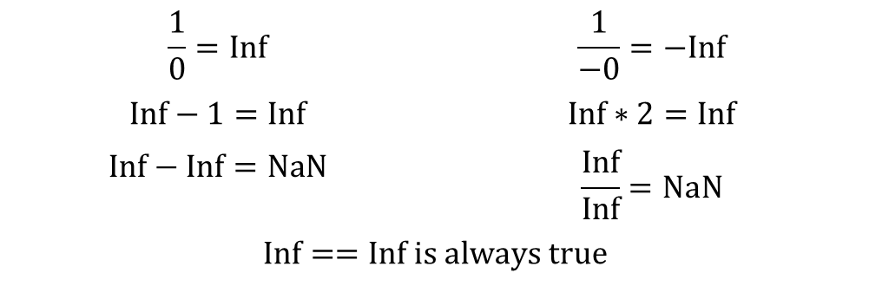

IEEE 754 Double Precision
Arithmetic with edge cases:
Denormals work according to the normal rules of arithmetic.
Inf and –Inf:
NaN:
$$\frac{1}{0}=Inf$$ | $$\frac{1}{−0}=−Inf$$
$$Inf−1=Inf$$ | $$Inf∗2=Inf$$
$$Inf−Inf=NaN$$ | $$\frac{Inf}{Inf}=NaN$$
$$Inf==Inf is always true$$
$$\frac{0}{0}=NaN$$ | $$\frac{0}{−0}=NaN$$
$$NaN==NaN is always false$$
Notes:
Outline
Building a C Executable
Exercise: Build and execute
Declaring variables
Formatted Input/output
Exercise: Read and print
Microsoft Visual Studio C++
File Input/output
Exercise: File I/O
Yes, -0 is a thing (but it’s equal to 0).

Slide 29
EPS, REALMAX, and REALMIN
EPS
Returns the difference between a number and the next exactly representable number.
eps(1) = 2.2204e-16 (about 16 decimal places of accuracy)
REALMAX
Largest floating-point number
realmax = 1.7977e+308
REALMIN
Smallest positive floating-point number
realmin = 2.2251e-308
Denormals can be smaller
Notes:
Outline
Building a C Executable
Exercise: Build and execute
Declaring variables
Formatted Input/output
Exercise: Read and print
Microsoft Visual Studio C++
File Input/output
Exercise: File I/O

Slide 30
Workbook Problem : 1

Slide 31
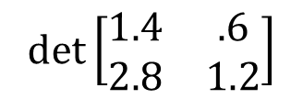
Numerical Linear Algebra
What does all of this have to do with Linear Algebra?
Let’s consider an extreme case in which we only have one decimal place of accuracy.
What is ?
$$det⁡\left[\begin{matrix}1.4 & .6 \\ 2.8 & 1.2\end{matrix}\right]$$
Notes:
Outline
Building a C Executable
Exercise: Build and execute
Declaring variables
Formatted Input/output
Exercise: Read and print
Microsoft Visual Studio C++
File Input/output
Exercise: File I/O
No, seriously, what is the determinant?

Slide 32
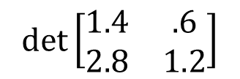

Numerical Linear Algebra
$$det⁡\left[\begin{matrix}1.4 & .6 \\ 2.8 & 1.2\end{matrix}\right]$$
What is ?
This matrix isn’t exactly representable (since we can only represent one decimal place), so it gets rounded to:
Thus, the computed determinant is -2
$$\left[\begin{matrix}1 & 1 \\ 3 & 1\end{matrix}\right]$$
Notes:
Outline
Building a C Executable
Exercise: Build and execute
Declaring variables
Formatted Input/output
Exercise: Read and print
Microsoft Visual Studio C++
File Input/output
Exercise: File I/O

Slide 33
Workbook Problem : 6 , 7

Slide 34
Self Paced: Workbook problems 2,3,4,5

